Slide 1
INTEGRATING MARKET SENTIMENTS WITH ARIMA/ARIMAX
PRESENTED BY: Pritha Tyagi (Batch 2018-2020, IMI New Delhi)
MENTORED BY: Dr. Kakali Kanjilal (Professor, IMI New Delhi)

Slide 2
WHAT WILL YOU LEARN?
Understand practical implementation of theory
Brief Introduction to sentiment Analysis
Understanding how to proceed with research/project?
Important things to keep in mind that you may miss otherwise.
How Literature Review can help.
How various techniques can come together to give a better picture.
Additional technique: Scraping NEWS Articles

Slide 3
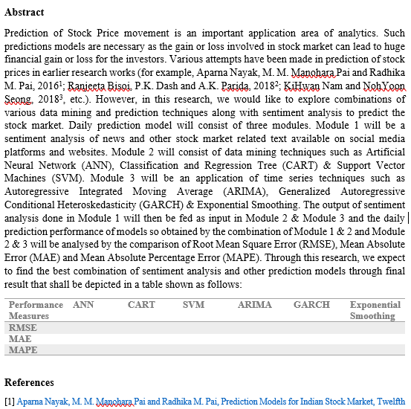
Understanding THE AIM OF THE PROJECT

Slide 4
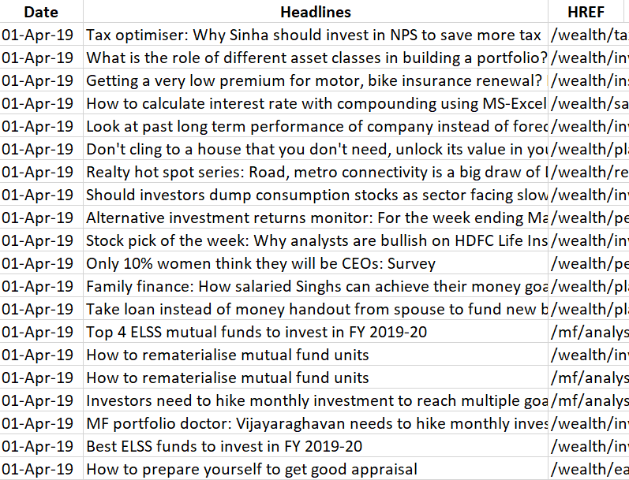
SENTIMENT ANALYSIS: THE DATA
Input Variables- Sensex Related NEWS Articles
Output- Daily Average Sentiment
Techniques-
Web Scraping to extract raw NEWS Headlines
Sentiment Analysis

Slide 5
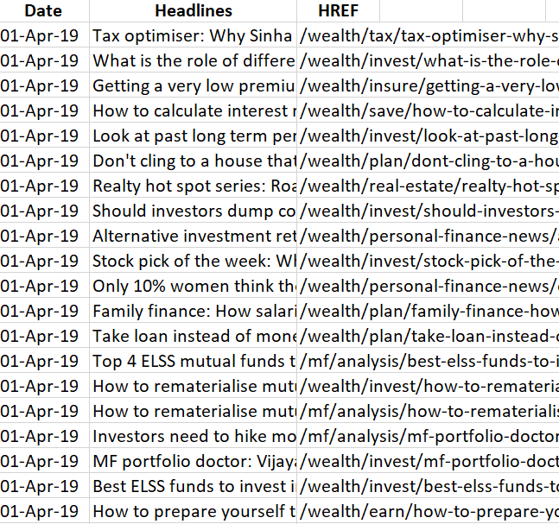
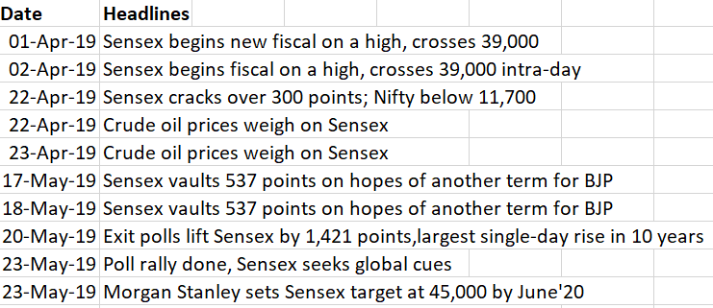
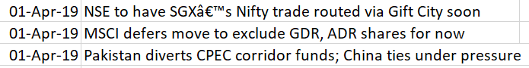
PRE-PROCESSING THE DATA
Sources- ET & BL website
6 Months daily Headlines data (April-Oct 2019)
Pre-process the data - get relevant NEWS headlines & clean the data
Remove duplicate headlines – can use links specific to stock to scrape the data
Remove advertisements & other unnecessary text

Slide 6
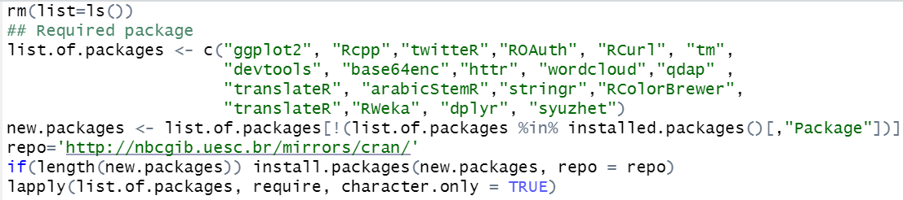
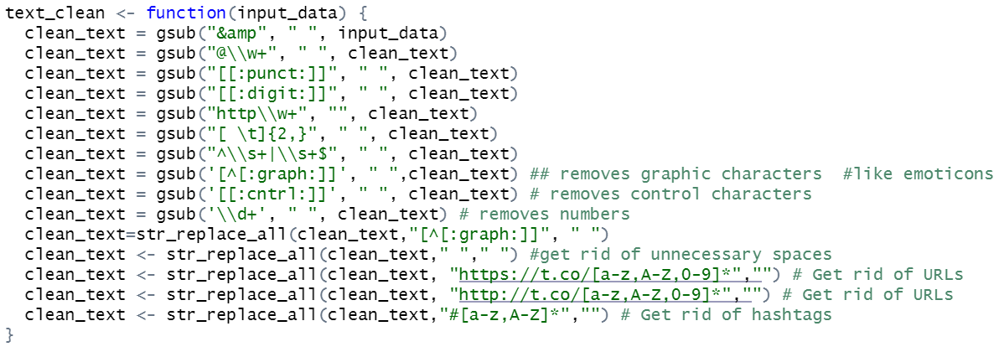
SENTIMENT ANALYSIS: UNDERSTANDING THE R-CODE

Slide 7
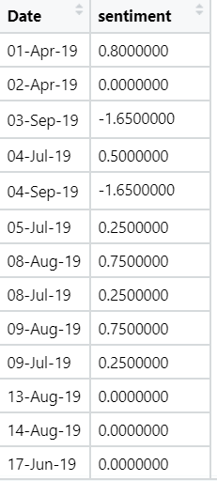
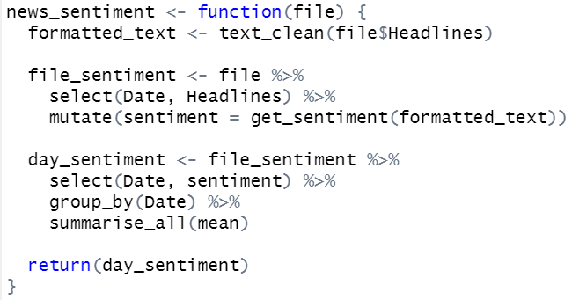
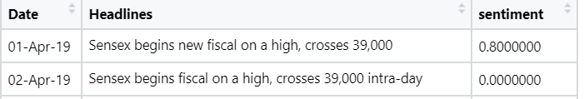
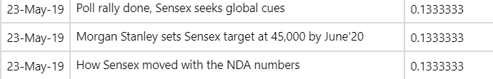
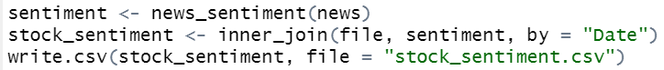
SENTIMENT ANALYSIS: UNDERSTANDING THE R-CODE

Slide 8
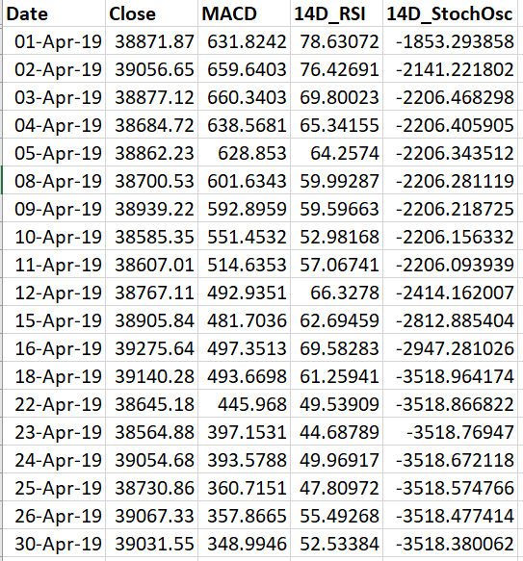
SENSEX DATA
Source- Moneycontrol
6 Months daily data (April-Oct 2019)
Literature Review
No stock price data available for holidays
MACD Indicator
14 Day Relative Strength Index (RSI)
14 Day Stochastic Oscillator

Slide 9
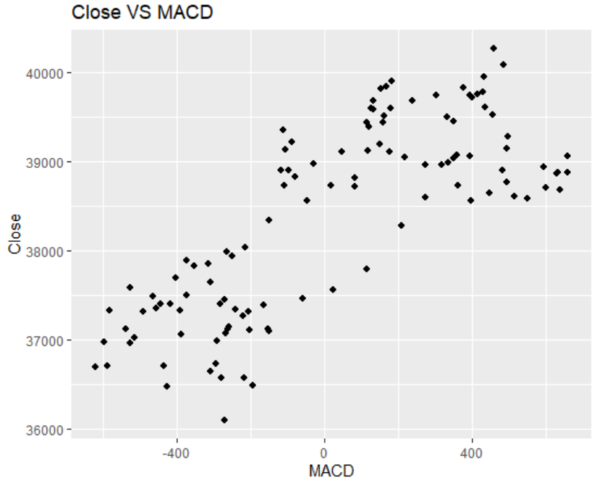
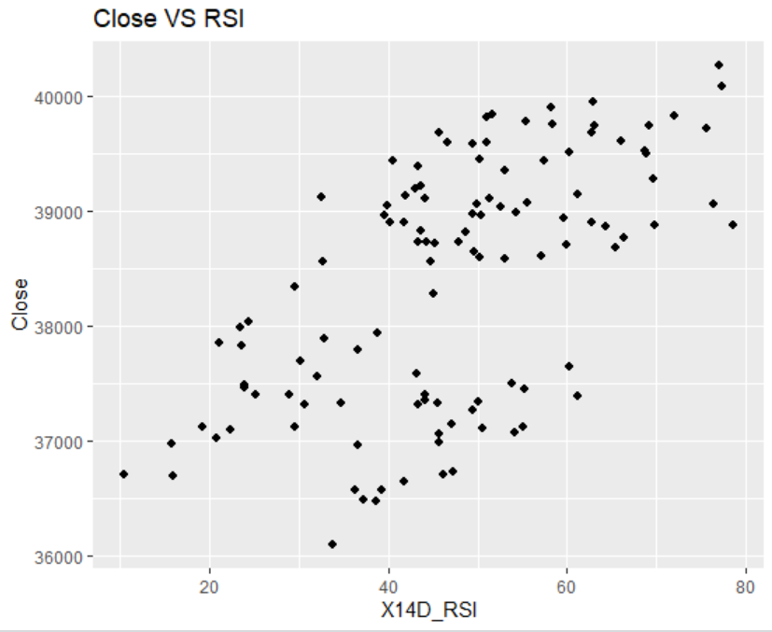
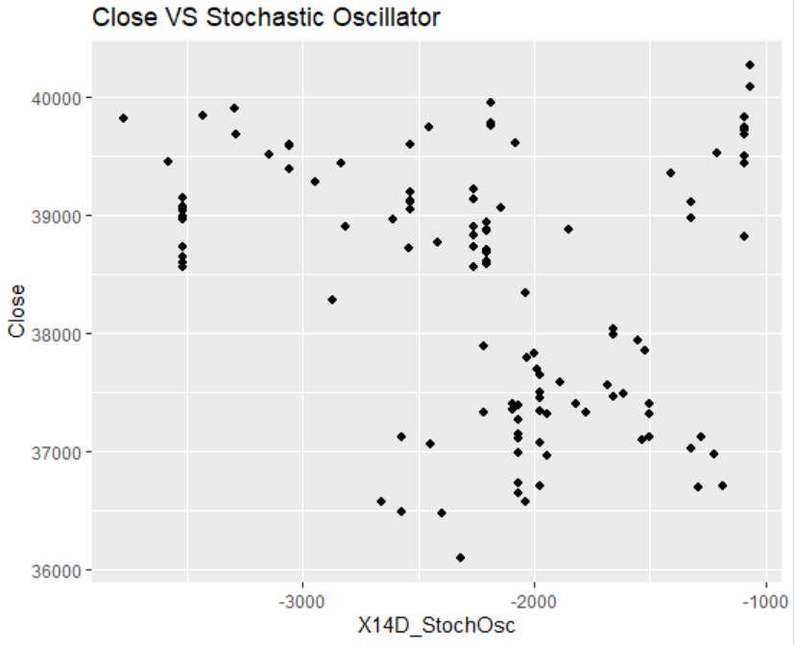

Slide 10
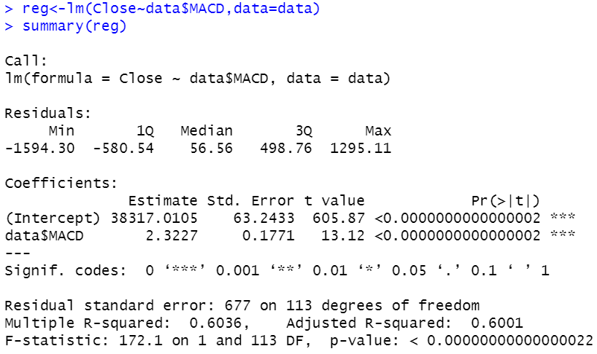
LINEAR REGRESSION: Close ~ MACD
F-stat p value: statistically significant
R-Squared value is high
Co-efficient sign as per expectations
Coefficient is statistically significant
Can use MACD as input variable for prediction.

Slide 11
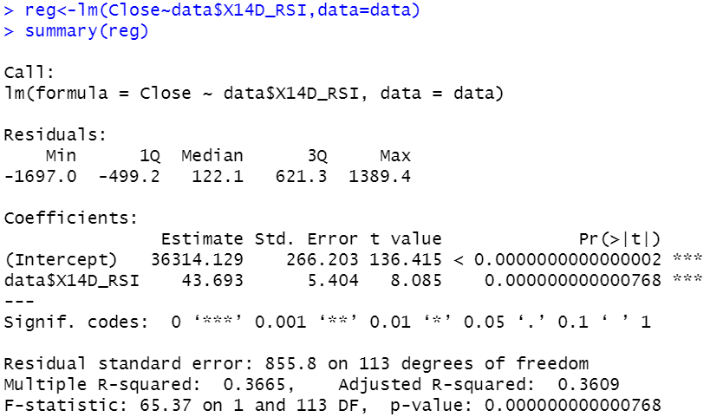
LINEAR REGRESSION: Close ~ 14 Day RSI
F-stat p value: statistically significant
R-Squared value is low
Co-efficient sign as per expectations
Coefficient is statistically significant
May use 14 Day RSI as input variable for prediction.

Slide 12
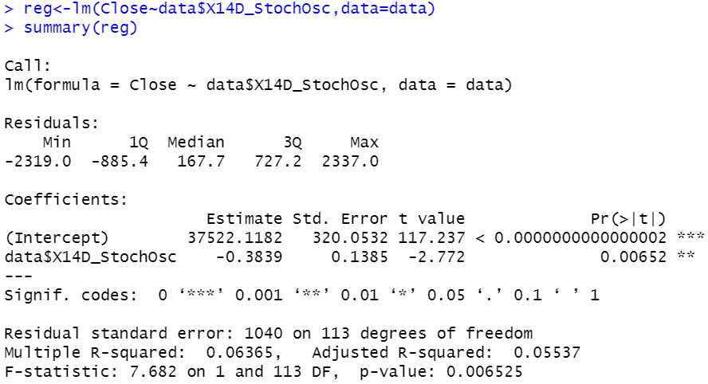
LINEAR REGRESSION: Close ~ 14 Day S.O.
F-stat p value: statistically significant
R-Squared value is very low
Can ignore 14 Day Stochastic Oscillator as input variable for prediction.

Slide 13
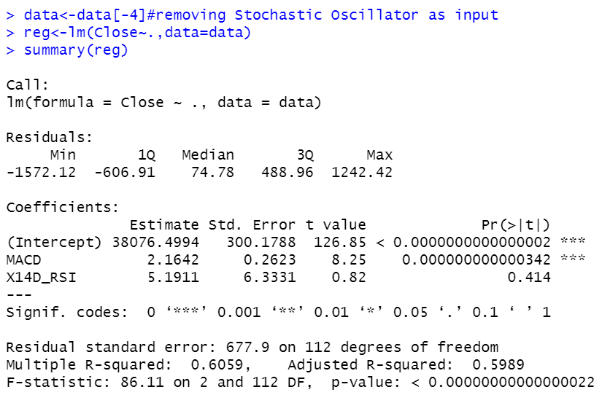
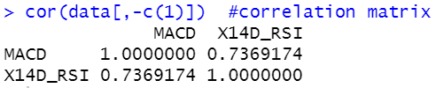
MULTIPLE REGRESSION: Close ~ MACD &14 Day RSI
F-stat p value: statistically significant
Adjusted R-Squared value is high
Co-efficient sign as per expectations
Coefficient of MACD only is statistically significant
MACD & 14Day RSI are positively related hence problem of “Multi-collinearity”.
Should take only MACD as input

Slide 14
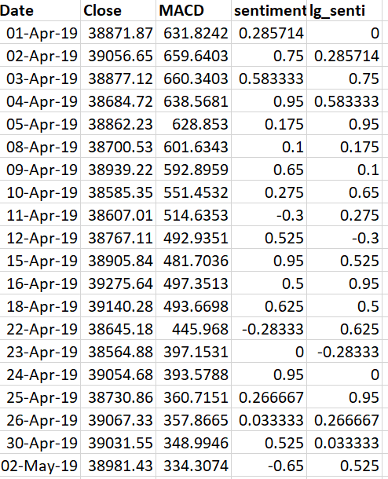
COMBINING THE DATA
Combine the daily average sentiment with respective stock data
ROWS: 115; COLUMNS: 5
MISSING VALUES: NA
TYPE: TIME-SERIES DATA
FREQUENCY: DAILY

Slide 15
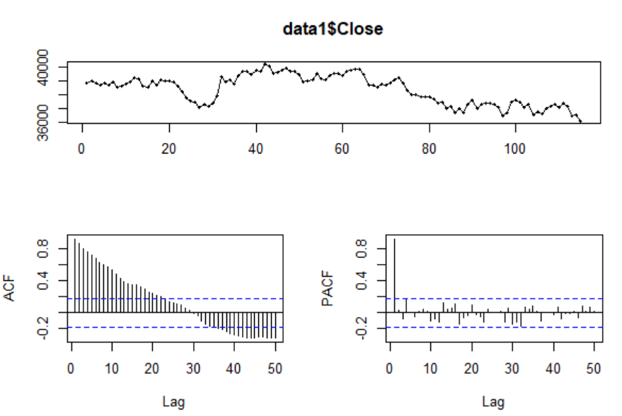
ARIMA MODEL
ACF: Values falling steadily
Data is non-stationary

Slide 16
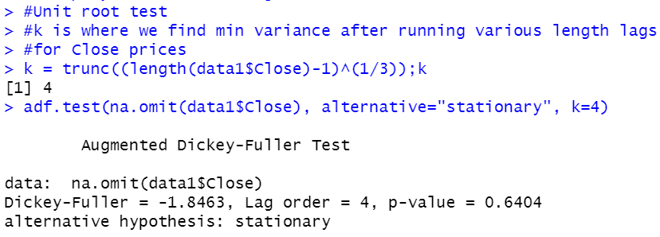
CONFIRMING NON-STATIONARITY
HYPOTHESIS UNIT-ROOT TEST:
H0 : Series is non-stationary
H1: Series is stationary
INFERENCE:
p-value > 0.05 significance level
Fail to reject the NULL
Series is non-stationary

Slide 17
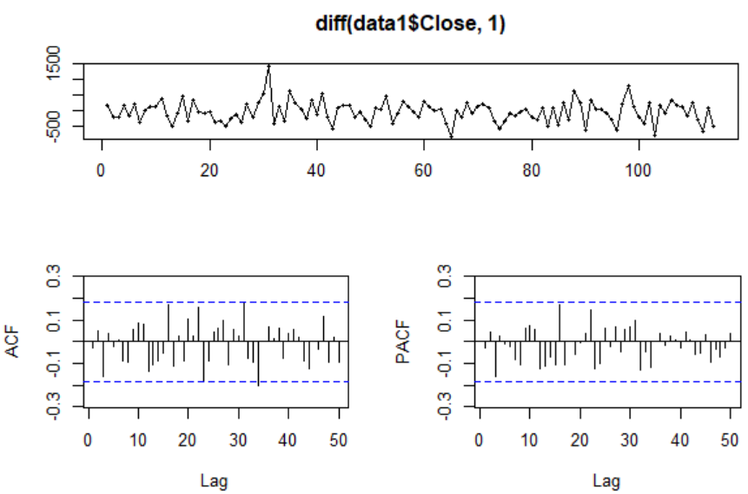
TREND DIFFERENCING
HYPOTHESIS ACF:
H0 : There is no autocorrelation
H1: There is autocorrelation
INFERENCE:
All bars lying inside the confidence interval (except 1) as per ACF, hence, fail to reject the NULL
There is ALMOST no autocorrelation, we only want to reduce autocorrelation but not remove it completely i.e. series has become white noise.
Cannot model the data

Slide 18
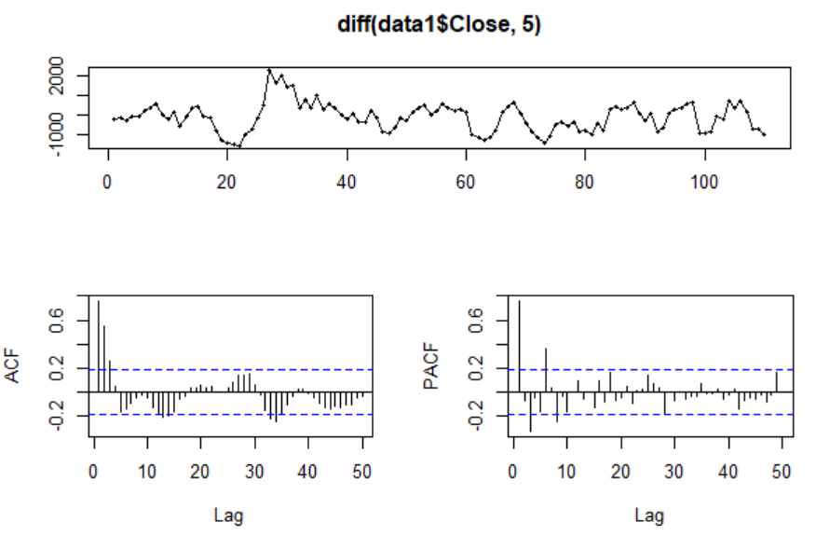
SEASONAL DIFFERENCING
INFERENCE:
ACF & PACF indicate that series has become stationary
ACF shows that mix of AR & MA is required for forecasting
PACF suggests ARIMA(1,0,1) & SARIMA(1,1,1)
SEASONAL DIFFERENCING yielded better result so we will proceed with seasonal differencing

Slide 19
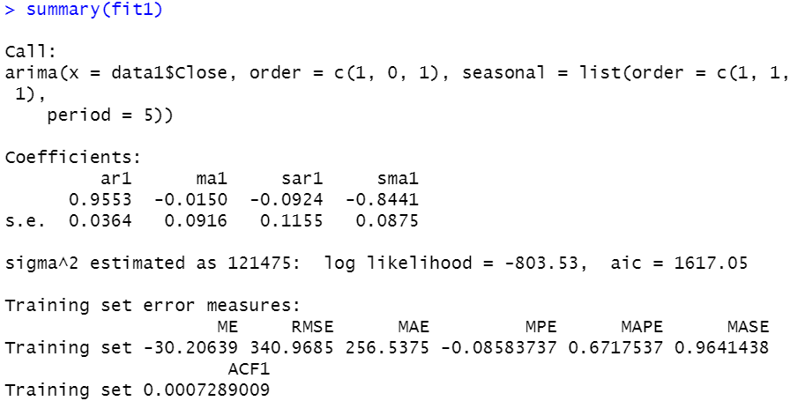
ARIMA(1,0,1)(1,1,1)
All Coefficients <1
ar1 is significant since
0.9553 > (2*0.0364)
ma1 is insignificant since
|-0.0150|< (2*0.0916)
sar1 is insignificant since
|-0.0924|< (2*0.1155)
Sma1 is significant since
|-0.8441|>(2*0.0875)

Slide 20
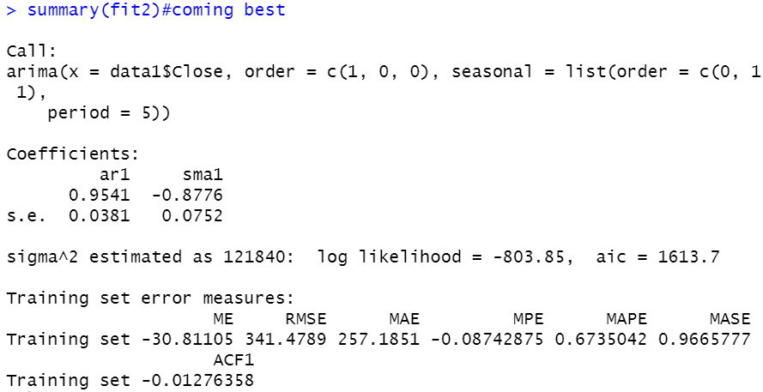
ARIMA(1,0,0)(0,1,1)
All Coefficients <1
ar1 is significant since
0.9553 > (2*0.0381)
Sma1 is significant since
|-0.8441|>(2*0.0752)
aic reduced!
MAPE very low

Slide 21
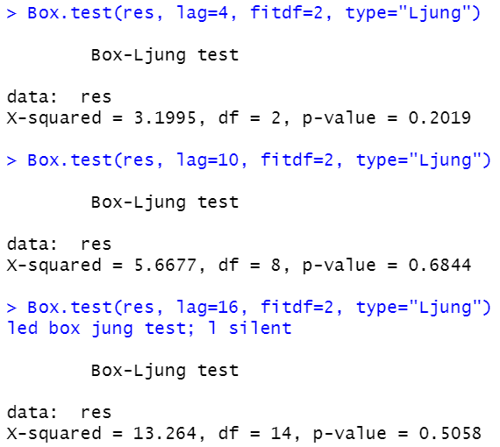
BOX-LJUNG TEST
HYPOTHESIS BOX-LJUNG:
H0 : Residuals are random
H1: Residuals are not random
INFERENCE:
For all three lags i.e. long term, medium-term & short term:
p-value > 0.05 significance level, hence, we fail to reject the NULL i.e. errors are random

Slide 22
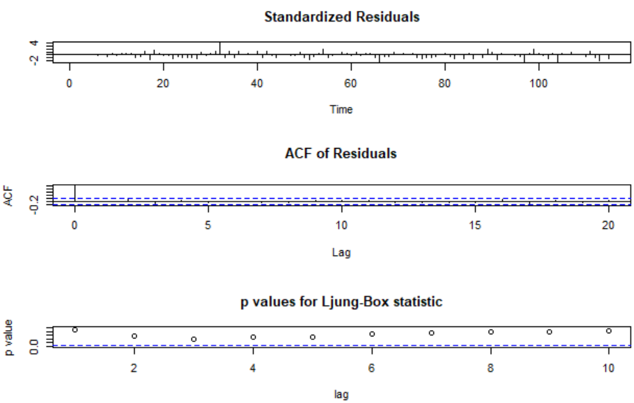
PLOT OF RESIDUALS

Slide 23
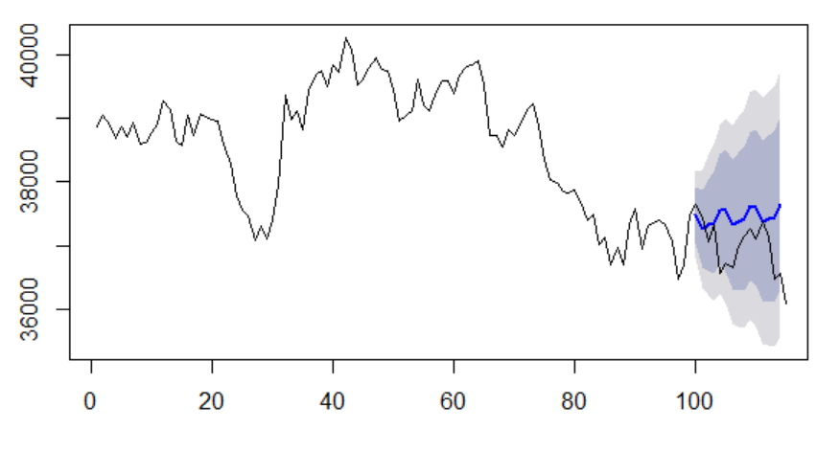
FORECAST
IN SAMPLE: 1:100
HOLD OUT SAMPLE: 101:115

Slide 24
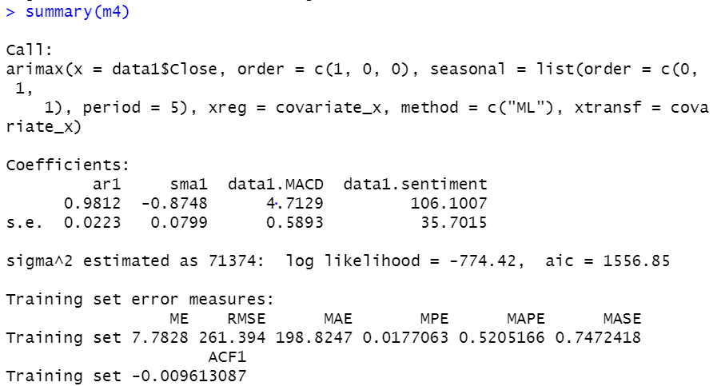
ARIMAX: CLOSE PRICE VS MACD & MARKET SENTIMENTS
All Coefficients are statistically significant
What’s the inference?

Slide 25
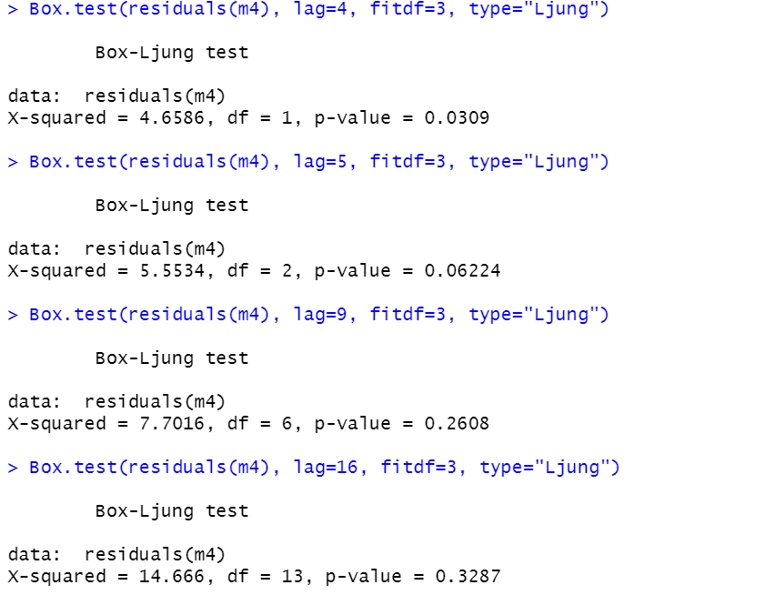
BOX-LJUNG TEST
What do you guys infer?

Slide 26
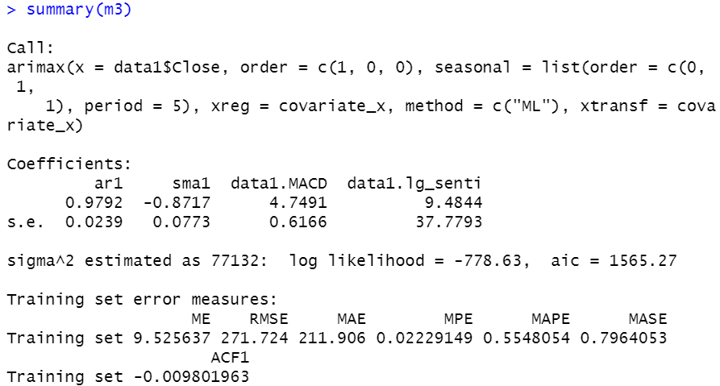
ARIMAX: CLOSE PRICE VS MACD & LAGGED MARKET SENTIMENTS
Earlier aic: 1556.85
aic has increased as compared to model with MACD & Market sentiments
What do you infer?

Slide 27
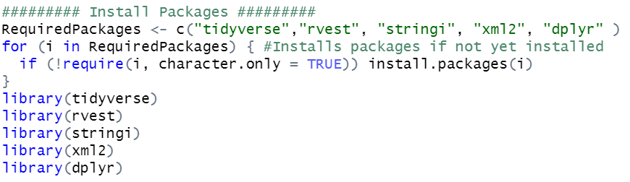
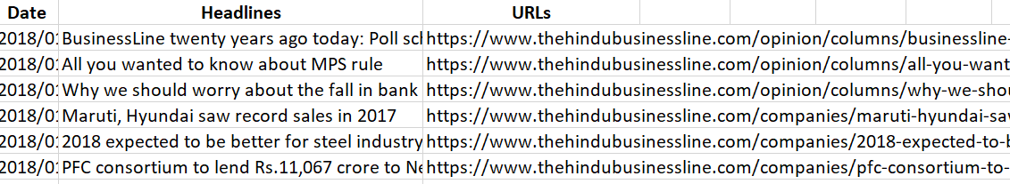
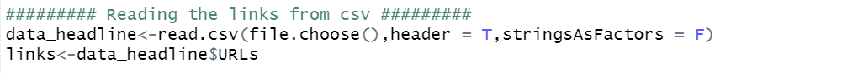
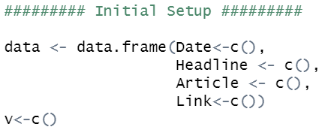
SCRAPING NEWS DATA FROM AVAILABLE LINKS

Slide 28
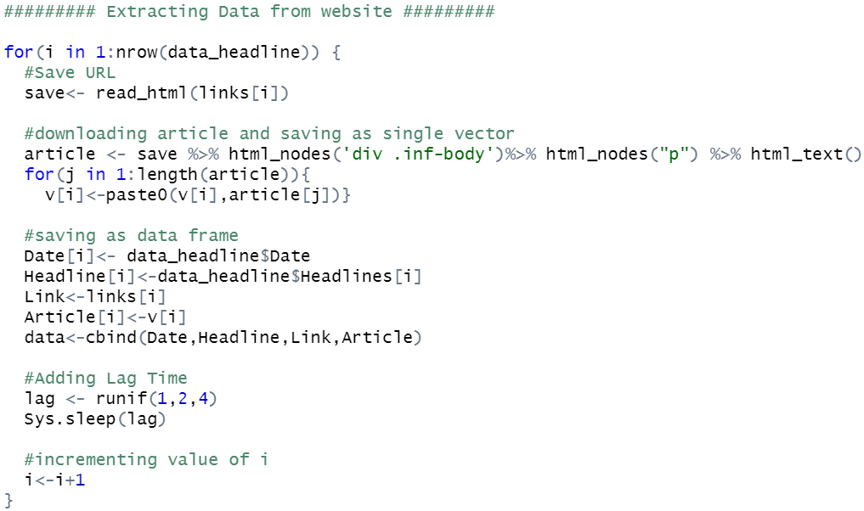
SCRAPING NEWS ARTICLES FROM AVAILABLE LINKS

Slide 29
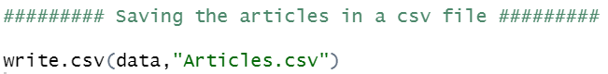
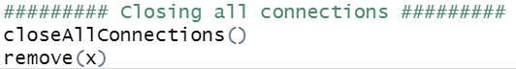
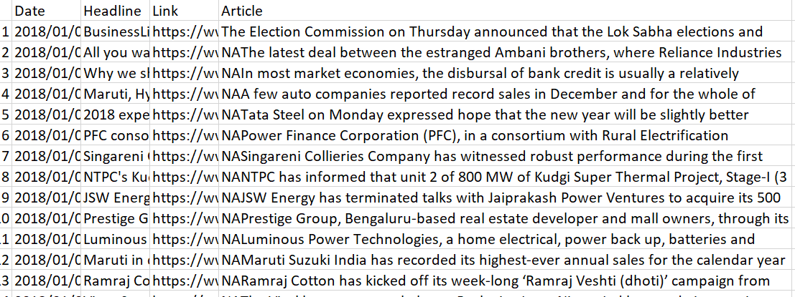
SCRAPING NEWS ARTICLES FROM AVAILABLE LINKS

Slide 30
Any Questions?
THANK YOU

